Slide 1
future sales prediction

Slide 2
Dataset Description
date – date in format dd/mm/yyyy
shop_id – unique identifier of a shop
item_id – unique identifier of a product
item_price – the current price of an item
item_cnt_day – number of products sold per day

Slide 3
Data Cleaning
Data cleaning is an essential step in preparing your data for future sales prediction or any data analysis task. Clean data ensures that your predictions are accurate and reliable. Here are some common data cleaning steps you should consider
Data Transformation:
Convert data types if necessary. For example, ensure that date fields are in a consistent date format and numerical fields are in the correct format.

Slide 4
Data Set
1 tv radio newspaper sales
2 230.1 37.8 69.2 22.1
3 44.5 39.3 45.1 12
4 17.2 45.9 69.3 12
5 151.5 41.3 58.5 16.5
6 180.8 10.8 58.4 17.9
7 8.7 48.9 75 7.2
8 57.5 32.8 23.5 11.8

Slide 5
Program
import pandas as pd
import numpy as np
from sklearn.model_selection import train_test_split
from sklearn.linear_model import LinearRegression
data = pd.read_csv("https://raw.githubusercontent.com/amankharwal/website-data/master/advertising.csv")
data.head()

Slide 6
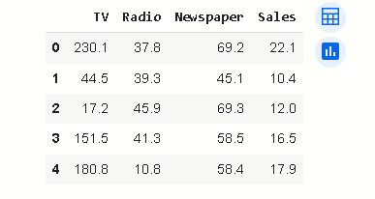
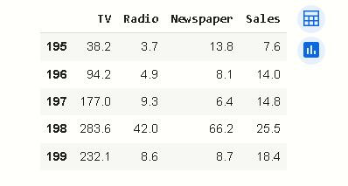
data.tail()

Slide 7

data.info()
data.isnull().sum()
import plotly.express as px
import plotly.graph_objects as go
figure = px.scatter(data_frame=data, x="Sales",
y="TV", size="TV", trendline="ols")
figure.show()

Slide 8
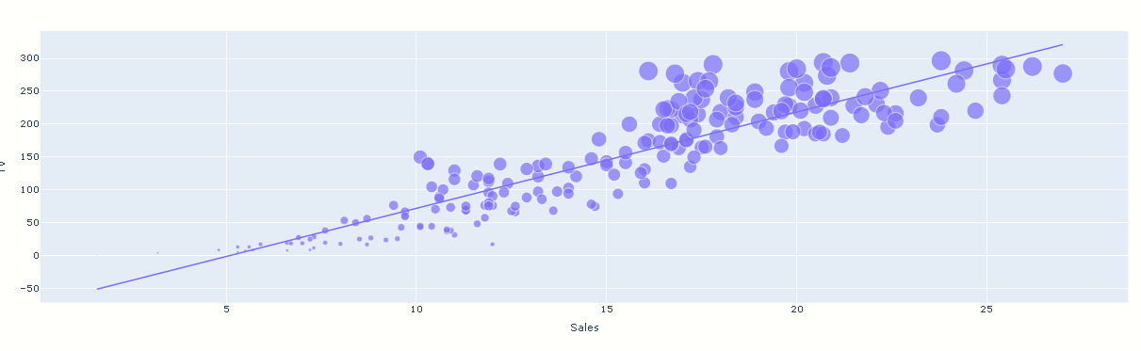
figure = px.scatter(data_frame=data, x="Sales",
y="Radio", size="Radio", trendline="ols")
figure.show()

Slide 9
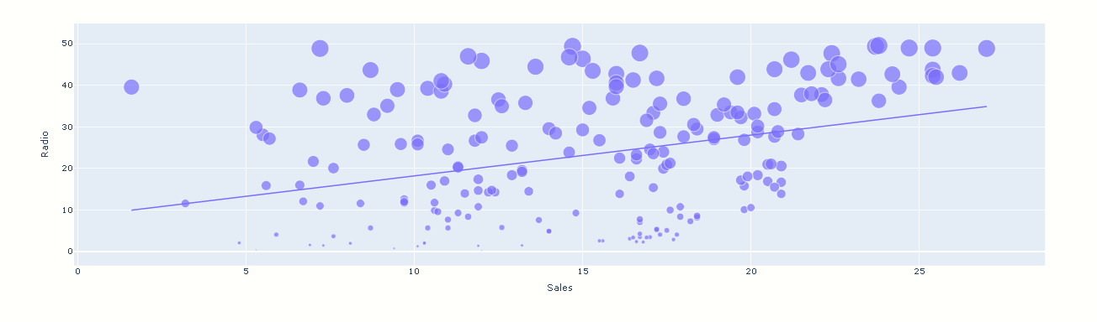
correlation=data.corr()
print(correlation["Sales"].sort_values(ascending=False))

Slide 10
x = np.array(data.drop(["Sales"], 1))
y = np.array(data["Sales"])
xtrain, xtest, ytrain, ytest = train_test_split(x,y,test_size=0.2,random_state=42)
model = LinearRegression()
model.fit(xtrain, ytrain)
print(model.score(xtest, ytest))
features = np.array([[230.1,37.8,69.2]])
print(model.predict(features))

